Slide 1
GreenCluster: Carbon-Aware Workload Scheduling using Big Data Analytics
Team Members
RaswanthKrishna M (CB.SC.U4AIE23266)
Mounindra Pullepu (CB.SC.U4AIE23273)
Hamsadhuvani JS (CB.SC.U4AIE23229)
Vaishnavi JSS (CB.SC.U4AIE23261)

Slide 2
INTRODUCTION
Modern data centers process millions of workloads every day and consume large amounts of electrical energy. This leads to high operational costs and significant carbon emissions. Data center telemetry generates massive volumes of monitoring data, including CPU usage, memory utilization, and network activity across thousands of machines. Analyzing this large-scale data using traditional tools is difficult. Big Data Analytics enables efficient processing of large telemetry datasets and helps extract useful insights for improving system efficiency.
In this project:
Large-scale cluster telemetry data is analyzed using Apache Spark.
Workload patterns are studied through time-series analysis and machine learning models.
A carbon-aware scheduling strategy is developed to run workloads during lower carbon intensity periods.
Goal: Improve energy efficiency in data centers by optimizing workload scheduling based on carbon intensity predictions.

Slide 3
Problem Statement
Modern data centers generate massive volumes of telemetry data from thousands of machines, including CPU usage, memory utilization, and network activity. Managing and analyzing this large-scale data efficiently is a major challenge.
Traditional data processing tools struggle to handle such high-volume and high-frequency monitoring data, making it difficult to extract meaningful insights in real time.
At the same time, data centers contribute significantly to energy consumption and carbon emissions. Current workload scheduling strategies often ignore variations in carbon intensity of electricity, leading to inefficient energy usage.
Therefore, the problem is:
To develop a scalable big data analytics pipeline that can process large-scale cluster telemetry data and enable carbon-aware workload scheduling to reduce overall emissions while maintaining system performance.

Slide 4
Objective
• Process large-scale data center telemetry data containing 95 million records using a scalable Big Data Analytics pipeline.
• Perform data cleaning, aggregation, and feature engineering using distributed processing with Apache Spark.
• Analyze workload patterns through time-series analysis and statistical methods.
• Forecast system workload behavior to understand future resource utilization trends.
• Develop a carbon-aware scheduling strategy that selects execution windows with lower carbon intensity.
• Reduce overall carbon emissions and improve energy efficiency in data center operations.

Slide 5
Dataset Overview
Dataset Name: Alibaba Cluster Trace Dataset (2018)
This dataset contains large-scale telemetry data collected from production data centers and provides detailed information about machine resource utilization.
Metric | Value
Total Records | ~95 Million
Total Machines | 4,023
Monitoring Duration | 8 Days
Sampling Interval | Every 5 Minutes
File Size | ~3.4 GB
Number of Features | 9

Slide 6
Dataset Overview
Main Features in Dataset
• machine_id – Unique identifier for each machine • time_stamp – Time at which the metrics were recorded • cpu_util_percent – CPU utilization percentage • mem_util_percent – Memory utilization percentage • mem_gps – Memory usage in GB • net_in – Incoming network traffic • net_out – Outgoing network traffic • disk_io_percent – Disk I/O utilization • mkpi – Machine performance indicator
Purpose of Using This Dataset
The dataset provides real-world large-scale infrastructure telemetry, making it suitable for big data analytics, workload forecasting, and carbon-aware scheduling analysis.

Slide 7
Literature Review
S.NO | PAPER TITLE & YEAR | DATA USED | TECHNIQUES USED | KEY CONTRIBUTIONS | LIMITATIONS
1 | Carbon-Intelligent Computing for Datacenters + DRO Extension (Google 2025, Hall et al. 2021) | Google proprietary fleet data, historical daily load profiles, carbon intensity signals | Virtual Capacity Curves (VCC), Distributionally Robust Optimization (DRO), CVaR tail-risk constraints, Wasserstein ambiguity sets, Large-scale LP solver | Production-scale load shaping system that delays flexible workloads away from high-carbon-intensity hours; provides probabilistic performance guarantees via CVaR; deployed at Google-scale infrastructure | No explicit forecasting component exposed; aggregate-level optimization only (no per-machine analysis); proprietary/internal implementation not reproducible; requires infrastructure-level integration
2 | Cloud Computing Load Prediction Method Based on CNN-BiLSTM Model Under Low-Carbon Background (Zhang et al., Scientific Reports 2024) | Google Cluster Trace 2011 (~12K machines, 0–20% CPU utilization range) | CNN for spatial feature extraction, BiLSTM for temporal sequence modeling, hybrid CNN-BiLSTM architecture, dynamic server power model for carbon conversion | Achieves 34–52% MSE reduction compared to BP, LSTM, and BiLSTM baselines; converts predicted CPU load to power consumption and carbon emissions via dynamic server power model | No uncertainty quantification on forecasts; predictions not connected to any scheduling decision; tested only on low-utilization dataset (0–20% CPU); no end-to-end pipeline integration
3 | Dual-Splitting Conformal Prediction for Multi-Step Time Series Forecasting (Yu et al., Applied Soft Computing 2025) | Solar irradiance, sapflow, air quality, wind power datasets (non-datacenter) | DSCP with signed residuals for asymmetric bounds, k-means + soft-DTW vertical splitting, Kolmogorov-Smirnov tests for horizontal merging, LSTM as base predictor | 23.6% Winkler Score improvement over baseline conformal methods; produces asymmetric prediction intervals; simulation case study shows 8–11% carbon reduction in data center optimization | High computational complexity (DTW clustering + K-S tests); scheduling is simulation-only (not real workloads); not validated on actual datacenter CPU traces; requires careful hyperparameter tuning

Slide 8
Comparison
Dimension | Paper 1 (Google+DRO) | Paper 2 (CNN-BiLSTM) | Paper 3 (DSCP) | CarbonDC (Ours)
Dataset | Google fleet (proprietary) | Google Cluster 2011 (~12K machines) | Solar, sapflow, air, wind | Alibaba Cluster 2018 (4,023 machines, 95M rows)
CPU Utilization Range | Not reported | 0–20% (idle) | N/A | 25–60% (moderate-high)
ETL Pipeline | Internal/black-box | Basic pandas | Minimal | Spark distributed, 11.3× compression, Parquet
Data Selection | Not disclosed | Random | N/A | Diversity-based (utilization spread)

Slide 9
Big data tools used
1. Apache Spark: Apache Spark is a distributed data processing framework used to handle large-scale datasets efficiently.
Purpose in the project:
Processing 95 million telemetry records
Performing distributed data cleaning and aggregation
Enabling scalable analytics across multiple CPU cores
Key advantage: Faster processing due to in-memory distributed computation.
2. Spark SQL: Spark SQL provides a SQL interface for querying large datasets stored in Spark DataFrames.
Purpose in the project:
Performing data analysis using SQL queries
Implementing carbon-aware scheduling using window functions
Efficiently joining workload data with carbon intensity data
Key advantage: Allows complex analytics using SQL syntax on large datasets.

Slide 10
Big data tools used
3. Spark MLlib
Spark MLlib is the machine learning library integrated with Apache Spark.
Purpose in the project:
Feature engineering using VectorAssembler
Statistical analysis using Correlation and Summarizer
Extracting relationships between system metrics
Key advantage: Machine learning algorithms that scale to large datasets.
4. Apache Parquet
Apache Parquet is a columnar storage format optimized for big data processing.
Purpose in the project:
Storing processed telemetry data efficiently
Reducing storage size through compression
Improving query performance by reading only required columns

Slide 11
System Architecture
Distributed Data Processing • Spark DataFrame API • groupBy aggregation • Parallel computation
Apache Spark ETL • Schema enforcement • Data cleaning • Timestamp bucketing
Alibaba Cluster Dataset
Big Data Analytics • Spark MLlib • Correlation analysis • Distributed statistics • Window functions
Parquet Storage Layer • Columnar storage format • Data compression • Partitioned datasets
Carbon-Aware Scheduling • Spark SQL queries • Window ranking • Optimal job execution slot

Slide 12
Methodology
The proposed system processes large-scale data center telemetry using a Big Data Analytics pipeline built on Apache Spark. The methodology consists of several stages:
1. Data Ingestion The Alibaba Cluster Trace dataset containing ~95 million records is loaded into Apache Spark for distributed processing.
2. Data Preprocessing (Spark ETL) Raw telemetry data is cleaned and standardized using Spark operations.
• Schema enforcement for correct data types • Removal of invalid or corrupted values • Timestamp normalization into fixed time buckets

Slide 13
Methodology
3. Distributed Data Aggregation Spark DataFrame operations perform large-scale aggregation of machine metrics.
Example: 95M rows → ~8.4M aggregated rows
4. Data Storage Optimization Processed data is stored in Apache Parquet format for efficient compression and faster queries.
5. Big Data Analytics Spark MLlib is used for large-scale statistical analysis including correlation and rolling statistics.
6. Carbon-Aware Scheduling Spark SQL queries identify optimal execution windows based on carbon intensity levels to reduce emissions.

Slide 14
Spark ETL Processing
Apache Spark is used to perform distributed ETL (Extract, Transform, Load) operations on the large-scale Alibaba cluster dataset.
Extract • Load ~95 million telemetry records into Spark using a predefined schema.
Transform • Remove invalid sensor values • Handle missing data • Normalize timestamps into fixed time buckets • Aggregate machine metrics using groupBy
Load • Store processed data in Apache Parquet format for efficient storage and faster queries.
Key Benefit: Distributed Spark processing enables efficient handling of large-scale telemetry data across multiple CPU cores.

Slide 15
Big Data Analytics
After preprocessing, Apache Spark is used to perform large-scale analytics on the processed telemetry data.
Tools Used
• Spark MLlib – scalable machine learning and statistical library • VectorAssembler – converts multiple features into a single feature vector • Correlation Analysis – identifies relationships between system metrics • Summarizer – computes distributed statistics such as mean and variance
Analytics Performed
• CPU, memory, and network usage pattern analysis • Correlation between workload metrics • Statistical summary of cluster resource utilization
Purpose
To extract meaningful insights from large-scale telemetry data and understand system behavior across thousands of machines using distributed computation.

Slide 16
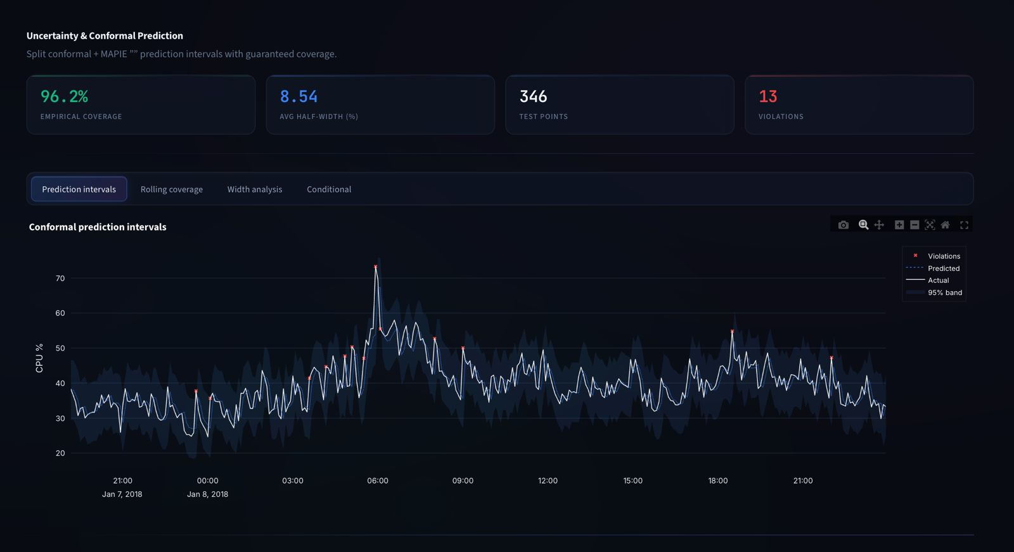
Results

Slide 17
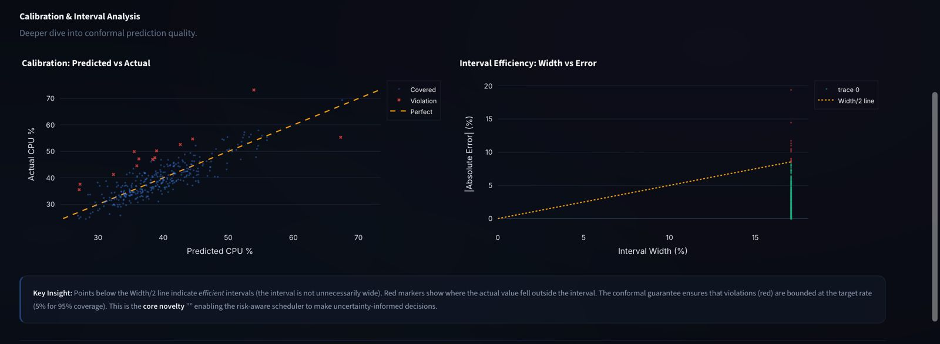

Slide 18
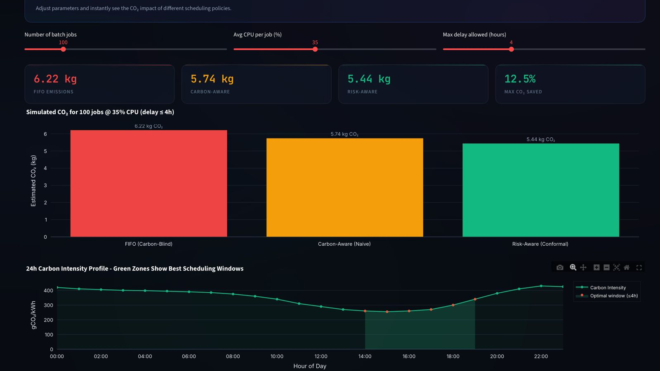

Slide 19
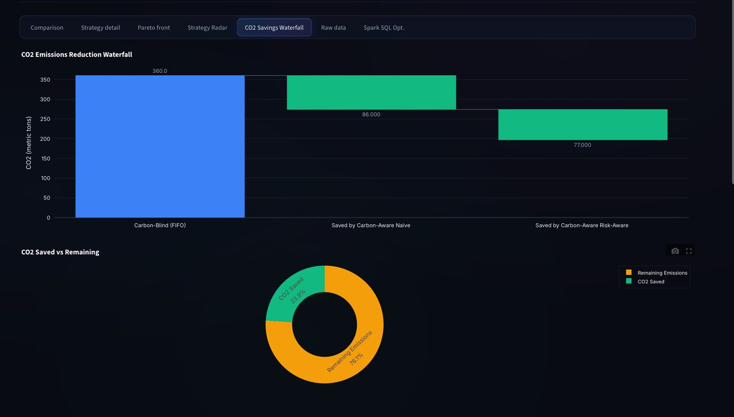

Slide 20
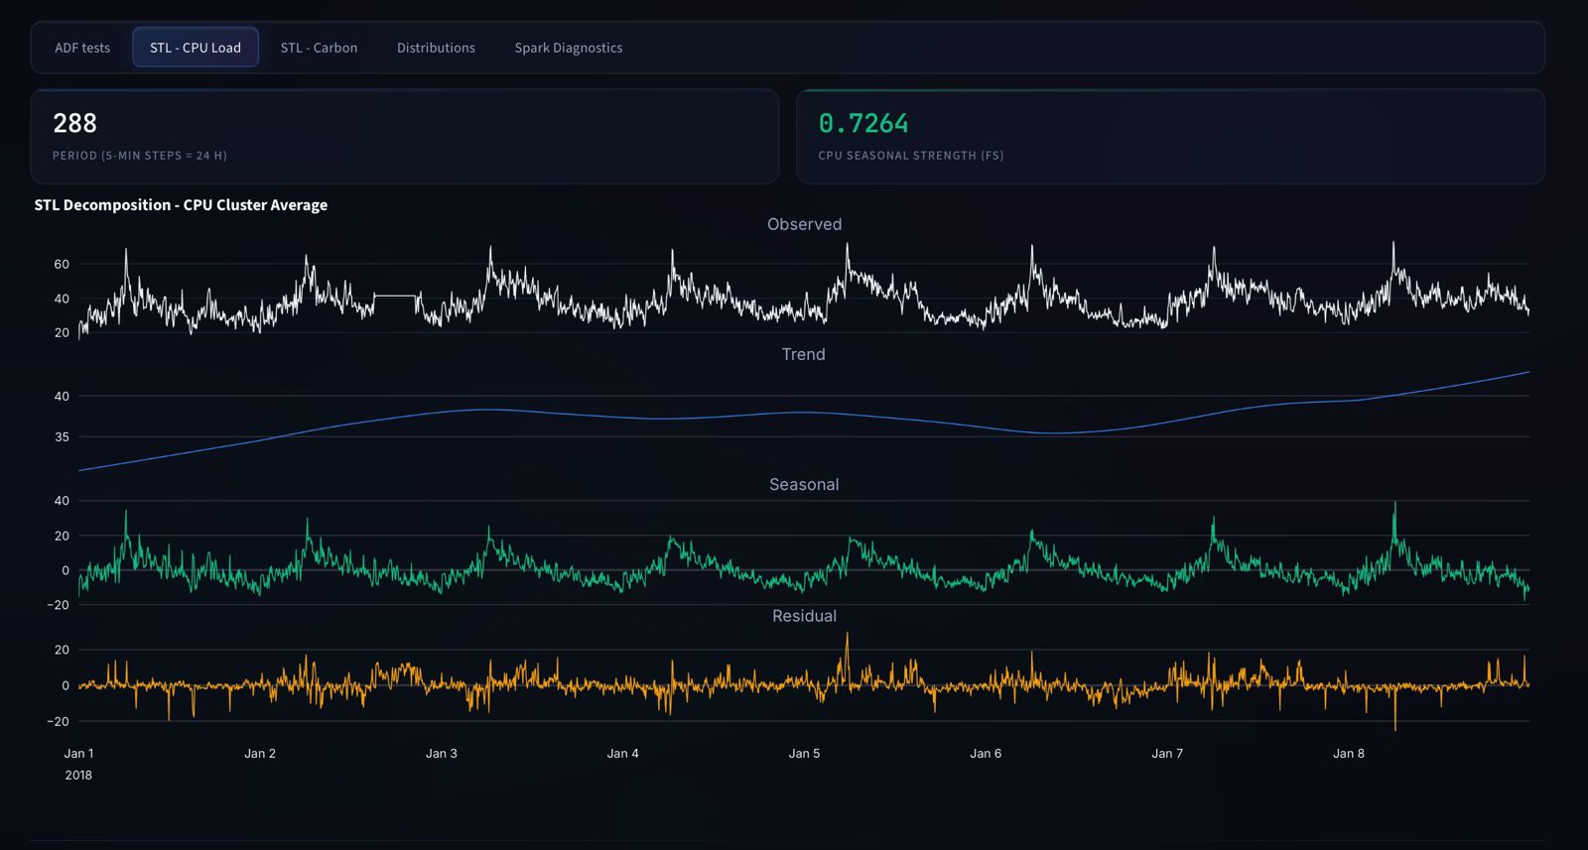

Slide 21
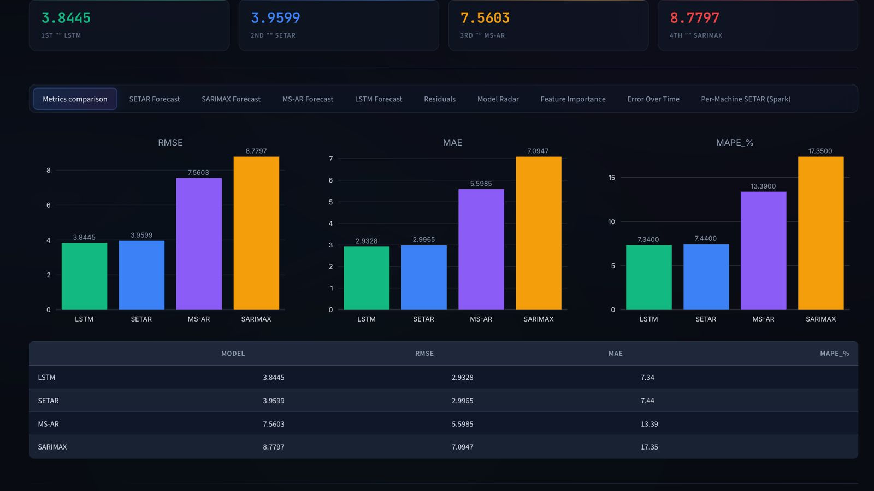

Slide 22
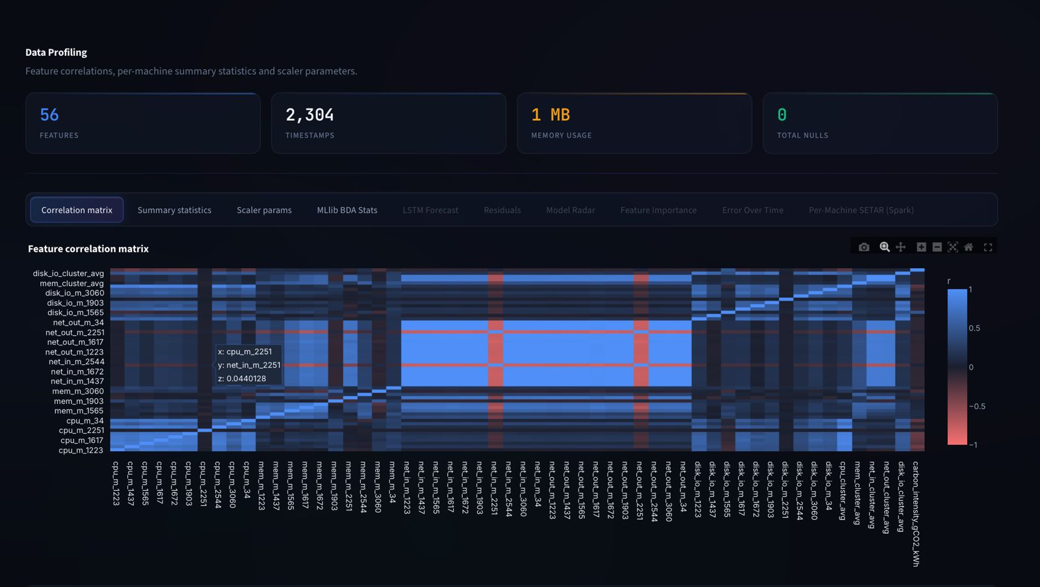

Slide 23
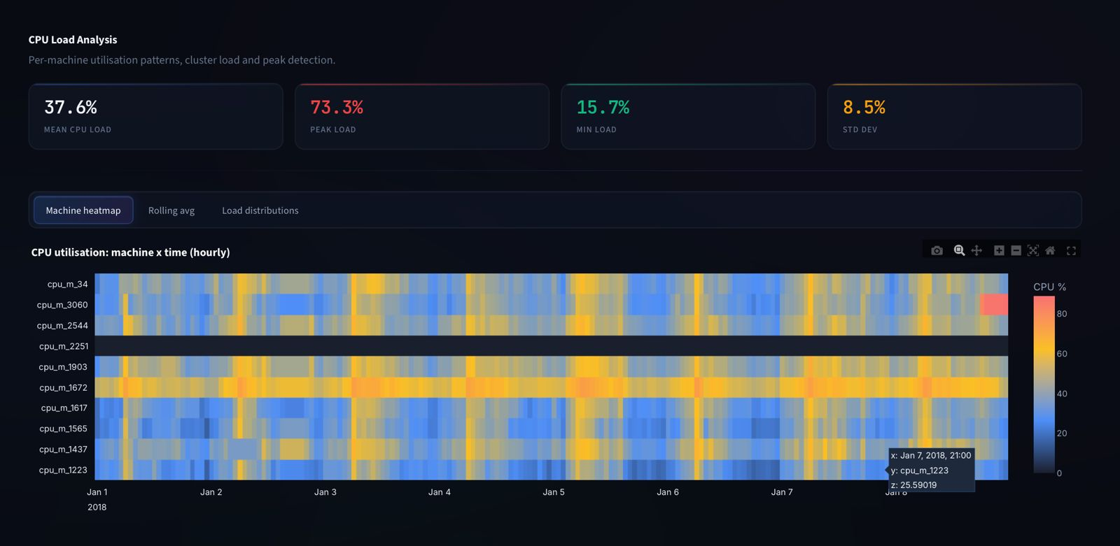

Slide 24
Conclusion
This project demonstrates how Big Data Analytics can be used to analyze large-scale data center telemetry and improve workload management.
Apache Spark enabled efficient processing of 95 million telemetry records through distributed ETL, aggregation, and large-scale analytics.
Key contributions of the system include:
• Scalable processing of large infrastructure datasets using Spark • Efficient storage and querying through Parquet columnar format • Large-scale statistical analysis using Spark MLlib • Carbon-aware workload scheduling using Spark SQL
Result: The proposed approach enables more energy-efficient data center operations and supports sustainable cloud computing practices.

Slide 25
THANK YOU

